Slide 1
PROJECT DEMONSTRATION
ServiceNow-Based Employee Laptop Request Application
Demo flow • Request creation • Validation • Approval • Security • Results

Slide 2
1. Problem & Objective
• Employees need a standardized way to request a laptop.
• Manual email/verbal requests make tracking and accountability difficult.
• IT needs validation, duplicate prevention, approval control and status visibility.
• Objective: centralize the complete laptop-request process in ServiceNow.
ServiceNow-Based Employee Laptop Request Application | 2

Slide 3
2. Solution Overview
• Employee opens the Laptop Request Record Producer.
• Employee enters requester, manager, laptop type and reason.
• Business Rule checks for an existing request in the same year.
• Flow Designer sends the request for manager approval.
• Status and notifications keep the requester informed.
• Roles and ACLs control what employees and managers can access.
ServiceNow-Based Employee Laptop Request Application | 3

Slide 4
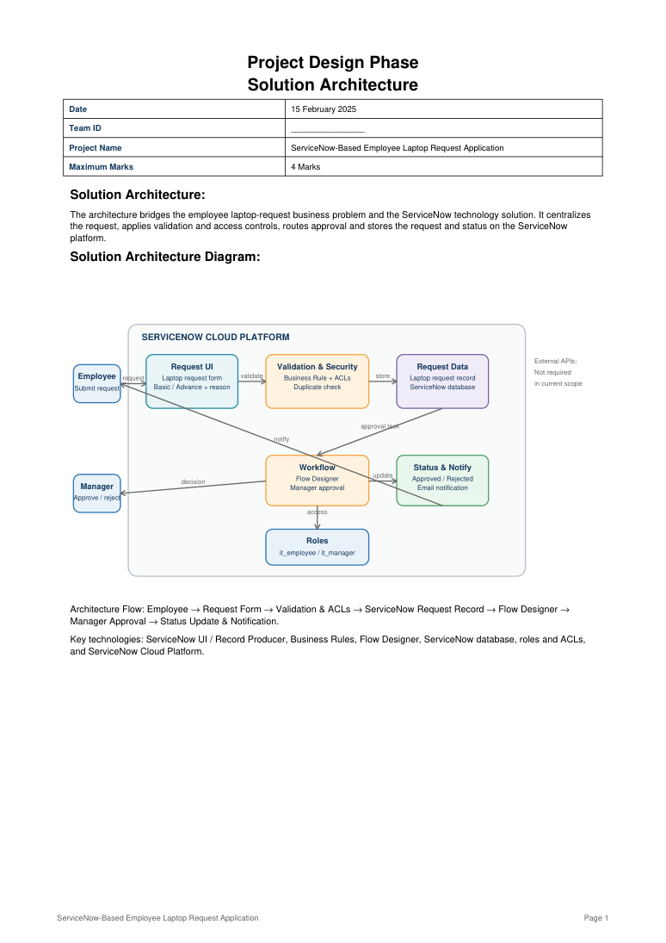
3. Solution Architecture
ServiceNow-Based Employee Laptop Request Application | 4

Slide 5
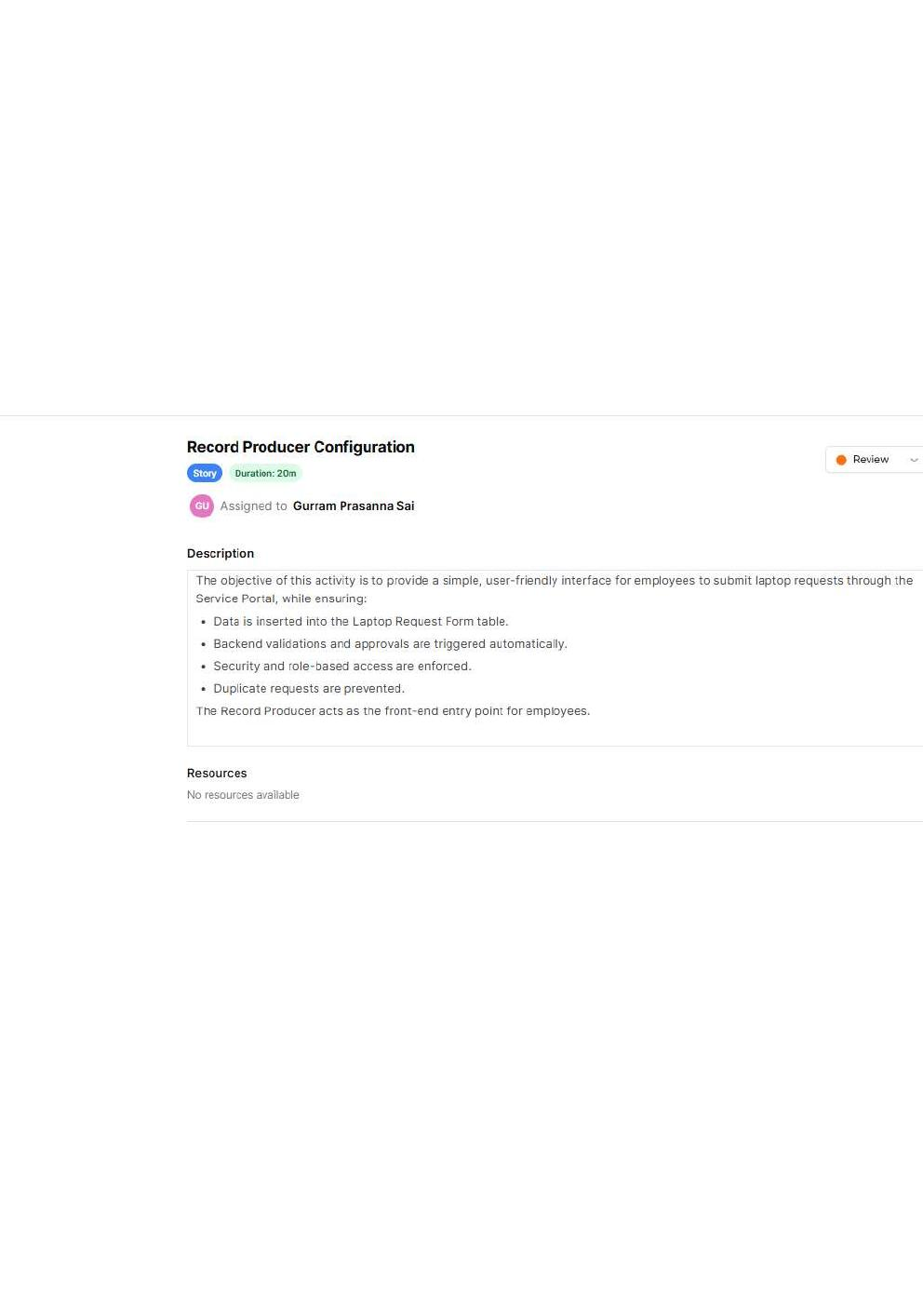
4. Demonstration — Employee Request
• Open the Service Catalog / Record Producer.
• Enter employee and manager details.
• Select Basic or Advance laptop type.
• Enter the business reason.
• Submit the request.
ServiceNow-Based Employee Laptop Request Application | 5

Slide 6
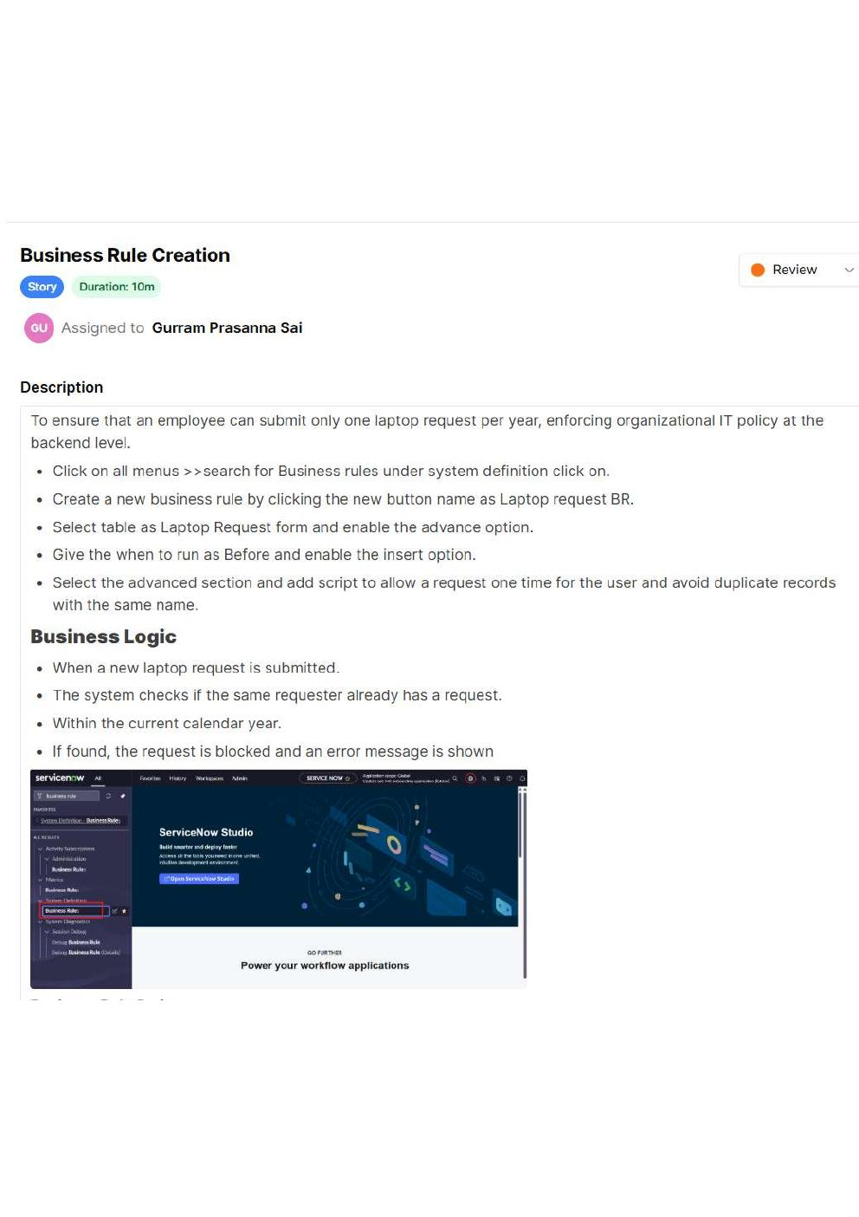
5. Demonstration — Duplicate Prevention
• The Business Rule checks whether the employee already has a laptop request in the current year.
• If a duplicate request is detected, submission is blocked.
• This enforces the yearly request policy automatically.
ServiceNow-Based Employee Laptop Request Application | 6

Slide 7
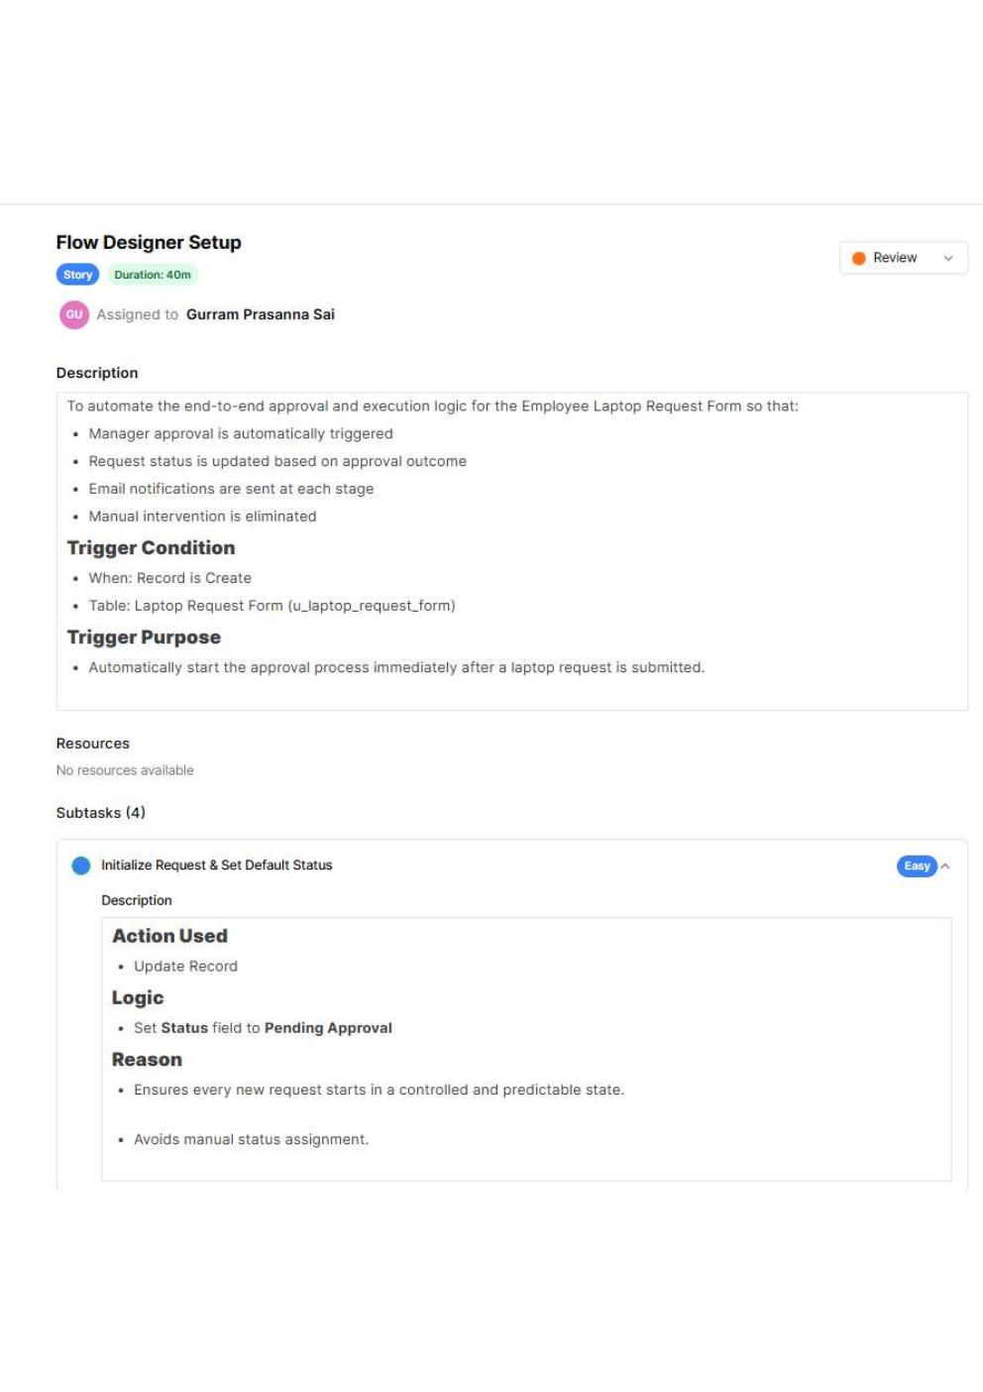
6. Demonstration — Approval Workflow
• Flow Designer starts after the request is created.
• Request is routed to the employee's manager.
• Manager approves or rejects the request.
• Request status is updated.
• Notification is sent to the employee.
ServiceNow-Based Employee Laptop Request Application | 7

Slide 8
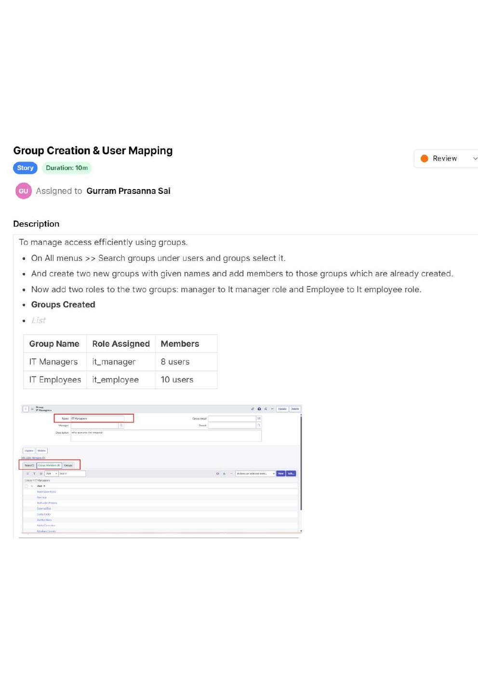
7. Demonstration — Security & Access
• it_employee role: create and manage employee requests.
• it_manager role: review requests for approval.
• ACLs enforce read/create/write permissions.
• Managers are prevented from creating or modifying requests outside their permitted access.
ServiceNow-Based Employee Laptop Request Application | 8

Slide 9
8. Testing & Expected Results
Test | Expected Result
Create request | Request is created successfully
Edit request | Employee can edit permitted fields
Duplicate in same year | Request is blocked
Manager review | Manager can view and approve/reject
Unauthorized edit | Access is denied
Workflow | Status and notifications update correctly
ServiceNow-Based Employee Laptop Request Application | 9

Slide 10
9. Demonstration Result
• Employee submits a standardized laptop request.
• System validates the request before approval.
• Duplicate yearly requests are prevented.
• Manager approval is automated through Flow Designer.
• Role-based access protects request data.
• The complete process is traceable in ServiceNow.
ServiceNow-Based Employee Laptop Request Application | 10

Slide 11
10. Deployment & Future Scope
• Update Set is used to package and move the ServiceNow configuration.
• Future scope: dashboards and management reporting.
• Future scope: integration with asset/laptop provisioning.
• Future scope: richer notifications and request-history visibility.
• Future scope: additional IT service-management automation.
ServiceNow-Based Employee Laptop Request Application | 11

Slide 12
11. Short Demo Script
• “First, I will log in as an employee and open the Laptop Request form.”
• “I will enter the required details and submit the request.”
• “Next, the Business Rule checks whether a request already exists for this employee in the same year.”
• “The request is then sent through Flow Designer to the manager for approval.”
• “Finally, I will show the status/notification and demonstrate the role-based access controls.”
ServiceNow-Based Employee Laptop Request Application | 12

